Slide 1
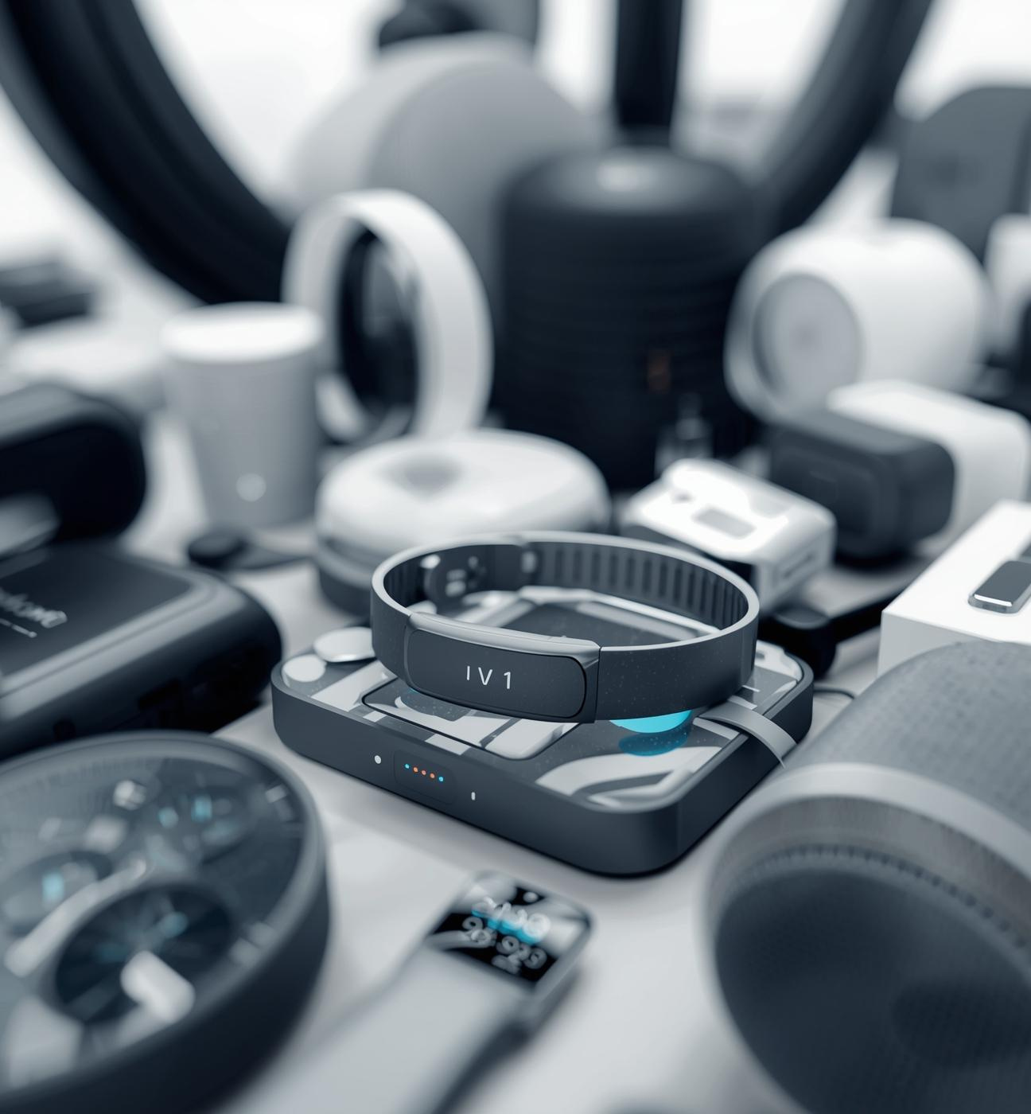
Internet of Things (IoT)
Presented by Pratyush Niraula,
February 4, 2026

Slide 2
What is IoT?
Connecting everyday objects seamlessly
IoT means connecting everyday objects to the internet so they can send and receive data, which helps make life easier, smarter, and more efficient for everyone.

Slide 3
How IoT Works
Understanding the data flow process
SENSORS
CLOUD
INFORMATION
Sensors collect data from the environment, detecting changes in conditions such as temperature, humidity, or movement.
The data collected by sensors is sent to the cloud, where it can be stored and analyzed for insights.
Users and devices receive information or commands back from the cloud, enabling real-time responses and actions based on data.

Slide 4
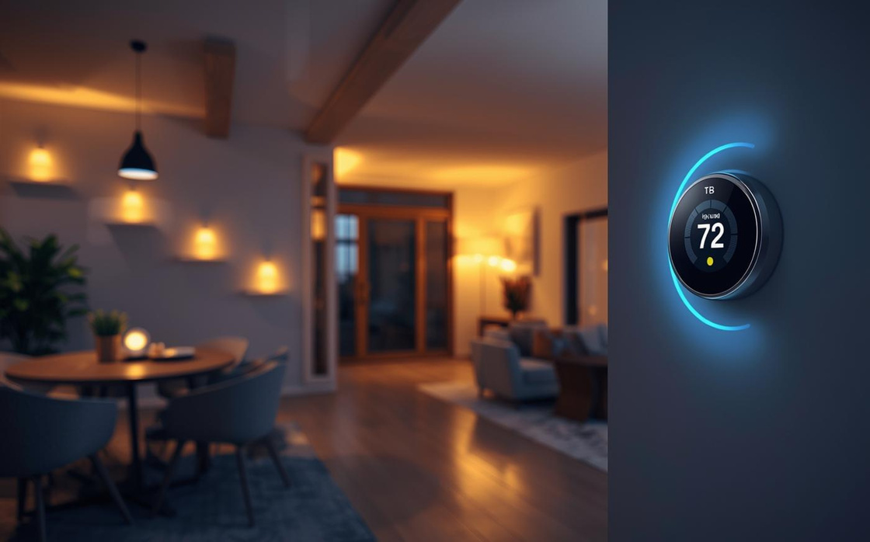
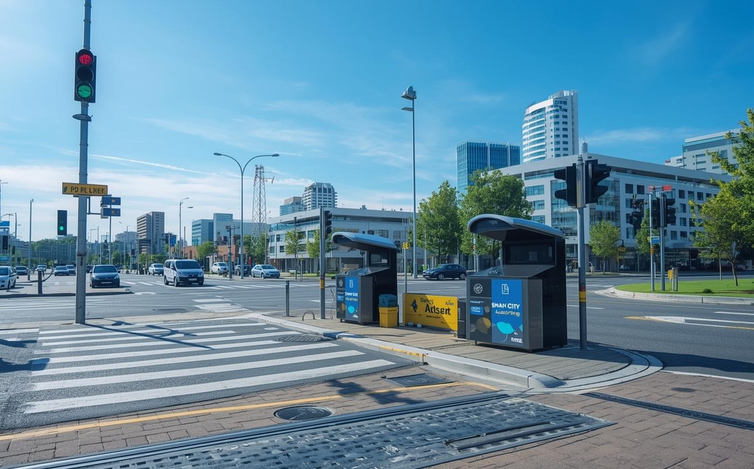
Everyday IoT Applications
Exploring how technology enhances life
IoT technologies transform our daily routines, enabling smart homes, wearables, and smart cities to improve convenience, efficiency, and quality of life.

Slide 5
Key Components
Essential elements of IoT systems
SENSORS AND DEVICES
CONNECTIVITY
DATA PROCESSING
Sensors collect data from the environment, enabling devices to interact with their surroundings effectively and intelligently.
Networks such as Wi-Fi and Bluetooth facilitate communication between devices, allowing data to be transmitted easily and promptly.
Cloud servers analyze the collected data, providing insights and enabling informed decisions while enhancing system functionality.

Slide 6
BENEFITS OF IOT
CHALLENGES OF IOT
  Convenience and automation
  Improved efficiency and cost savings
  Better health and safety monitoring
  The integration of IoT into daily life enhances user experiences, streamlining tasks and increasing productivity while ensuring safety and comfort in various environments.
  Privacy and security concerns
  High cost of devices and infrastructure
  Complexity in managing many devices
  Despite its advantages, IoT faces significant hurdles, including safeguarding user data and managing the financial investment required to build and maintain interconnected systems.

Slide 7
"By 2025, over 75 billion devices"
– INDUSTRY FORECAST

Slide 8
Thank You for Exploring the Internet of Things!

